Slide 1
Exploring Karachi’s Cabaret Dancers, 1960s/1970s
The case of Marzi Kanga

Slide 2
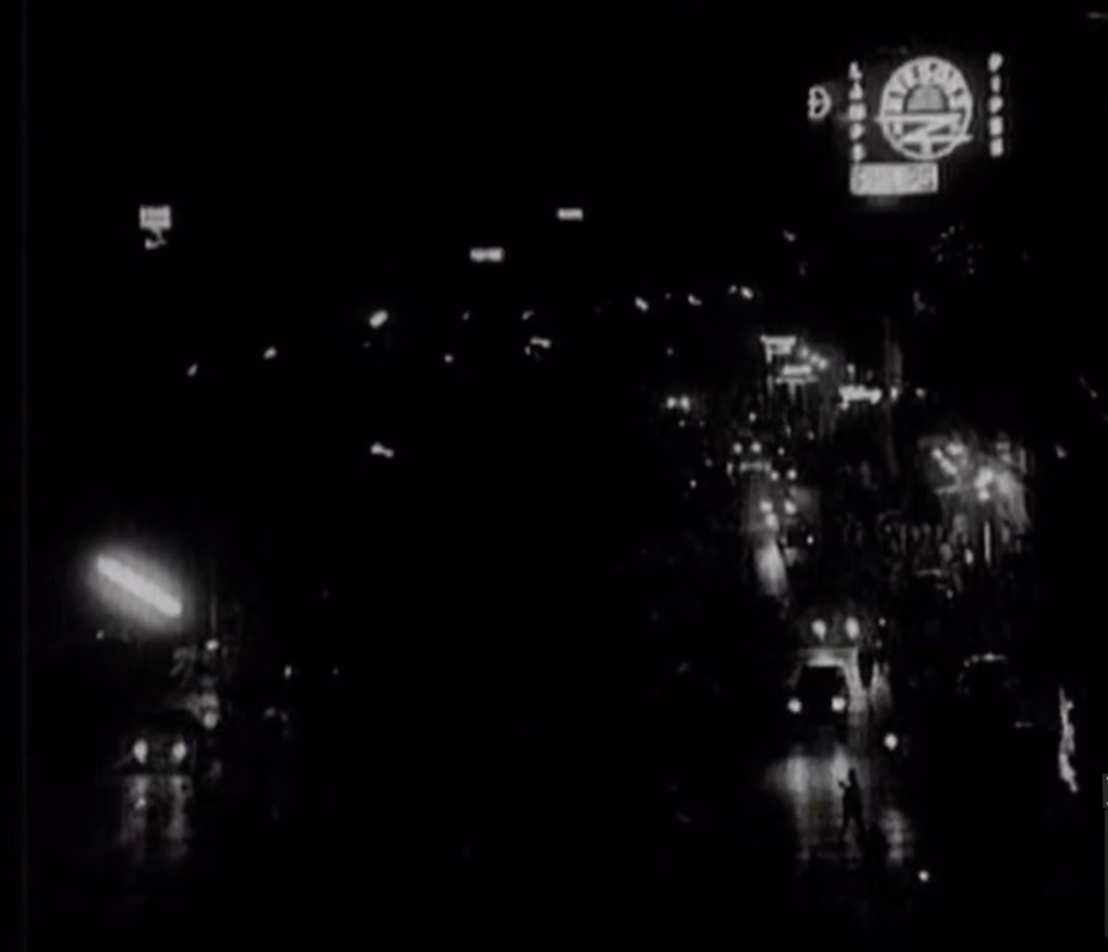
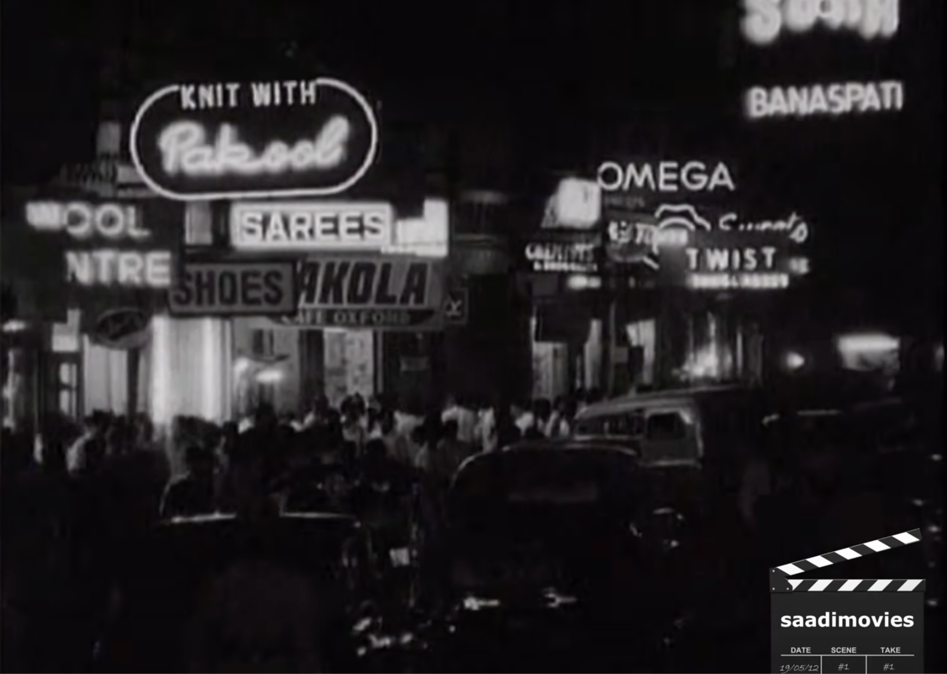
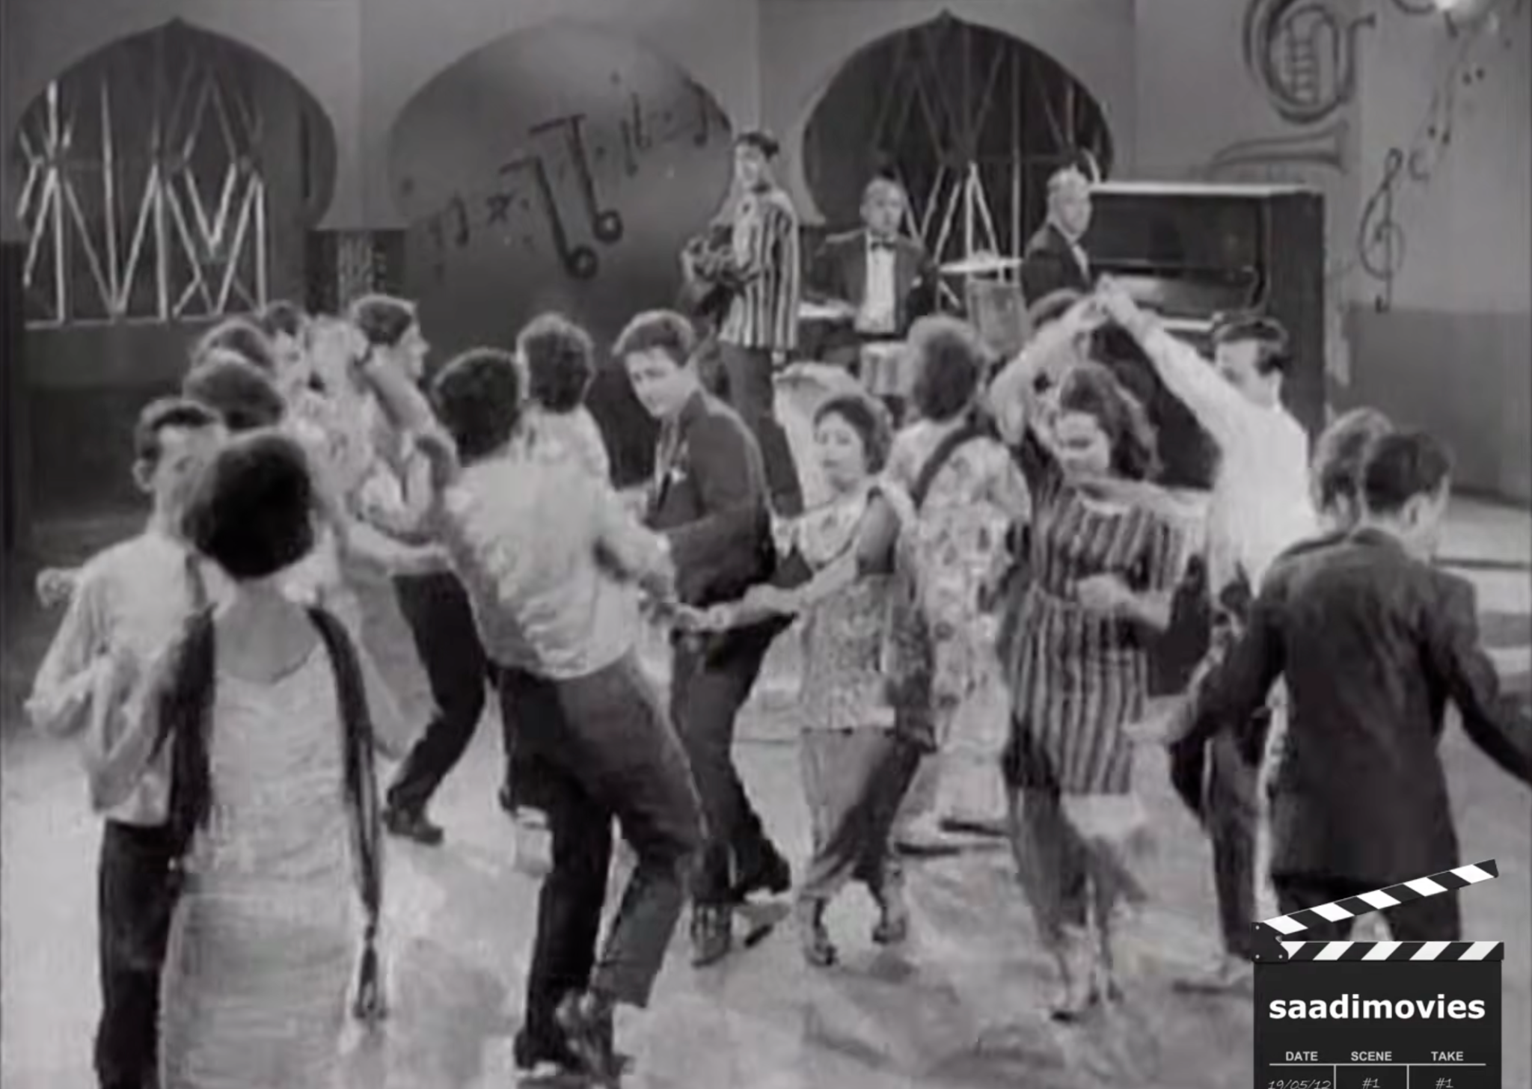
Notes:
Chingari, YouTube (Karachi: K.Z. Productions, 1964), https://www.youtube.com/watch?v=yjg_gvi6vMo.

Slide 3
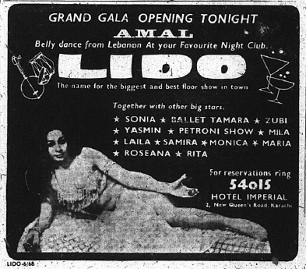
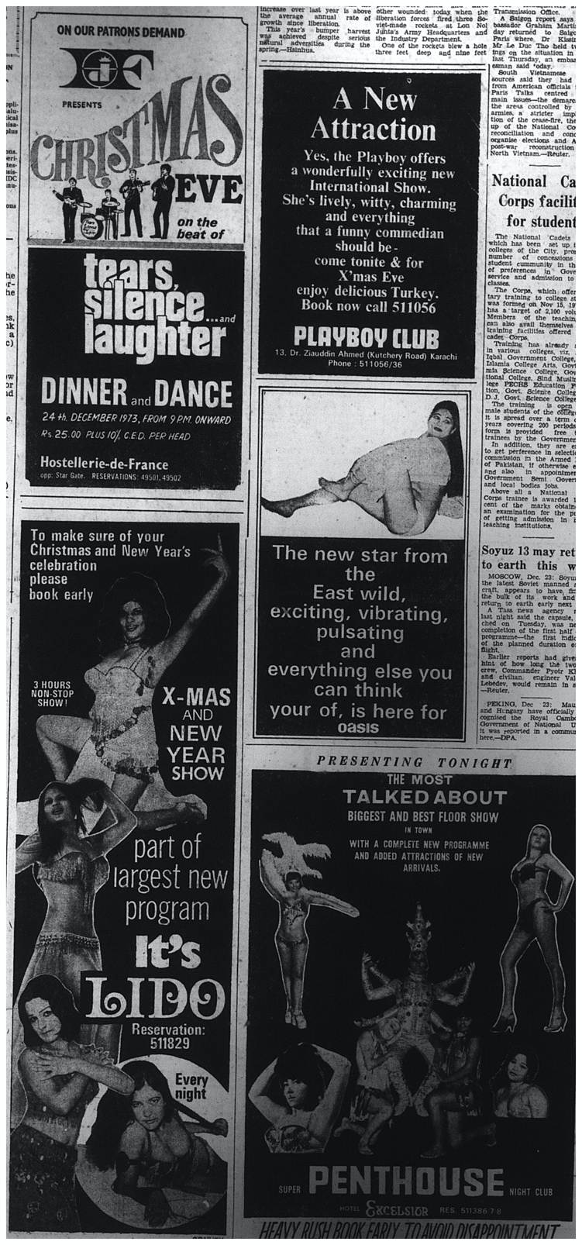
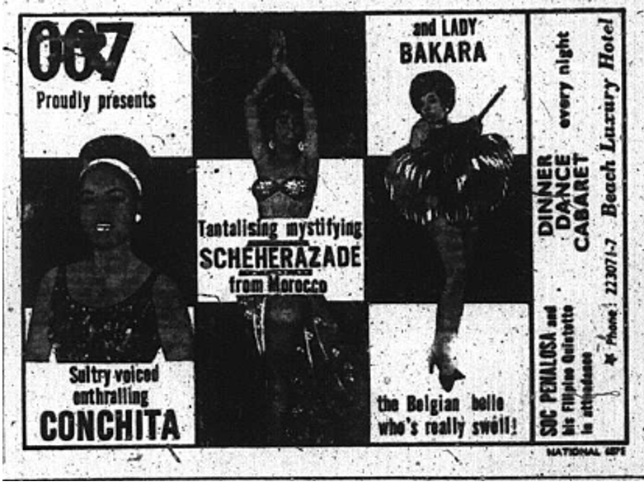
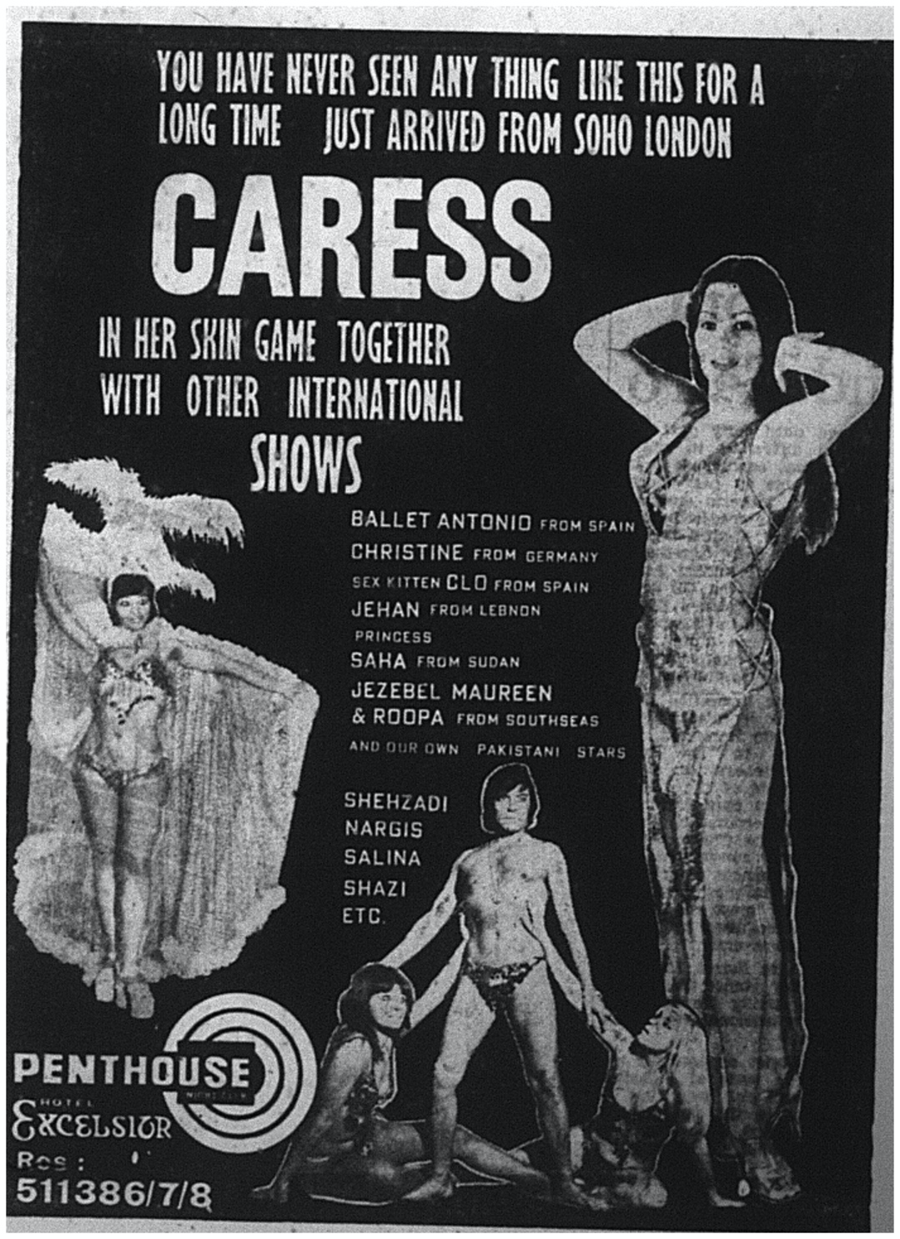
Notes:
Top left: Lido, “GRAND GALA OPENING TONIGHT: AMAL Belly Dance from Lebanon At your Favourite Night Club,” advertisement, Dawn, March 2, 1968.
Bottom left: 007, “007 Proudly presents,” advertisement, Dawn, March 9, 1968.
Bottom centre: Penthouse Nightclub, “YOU HAVE NEVER SEEN ANY THING LIKE THIS FOR A LONG TIME,” advertisement. Dawn, November 17, 1973.
Right: Section of a page, Dawn, December 24, 1973.

Slide 4
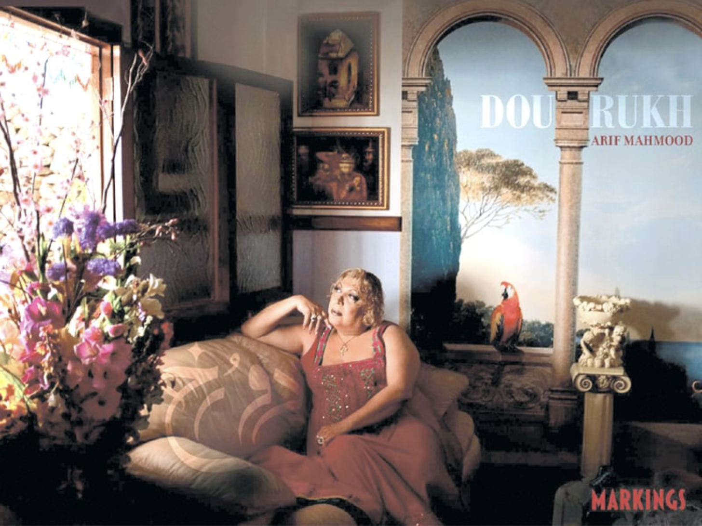
Notes:
Arif Mahmood, photographer, Marzi Kanga portrait, photograph, in Tapu Javeri, Arif Mahmood, and Aesha Arif, Dou Rukh (Karachi: Markings, 2011).

Slide 5
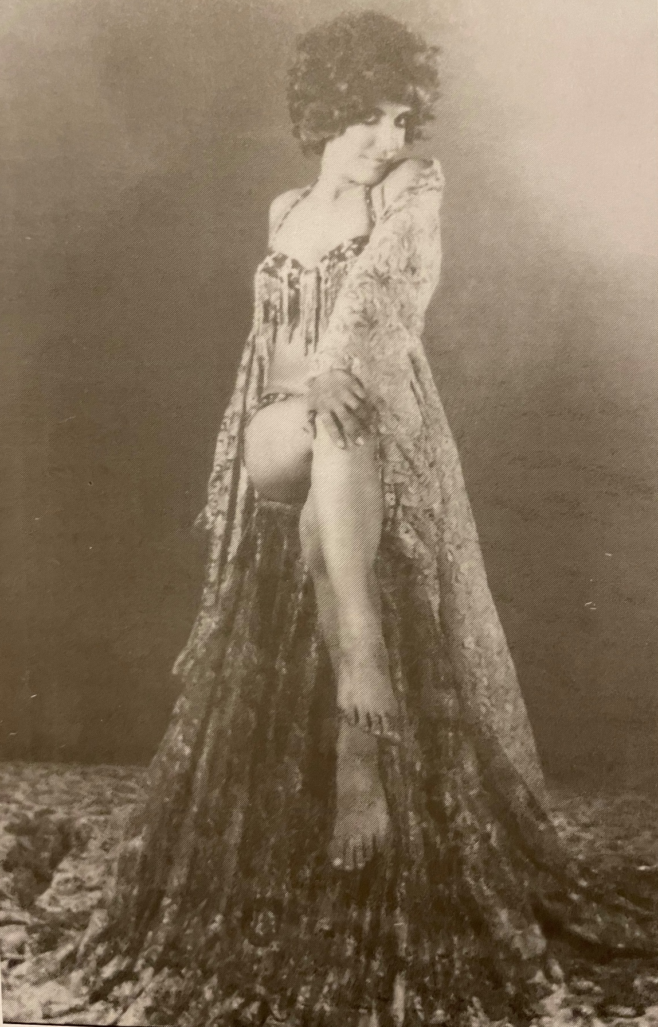
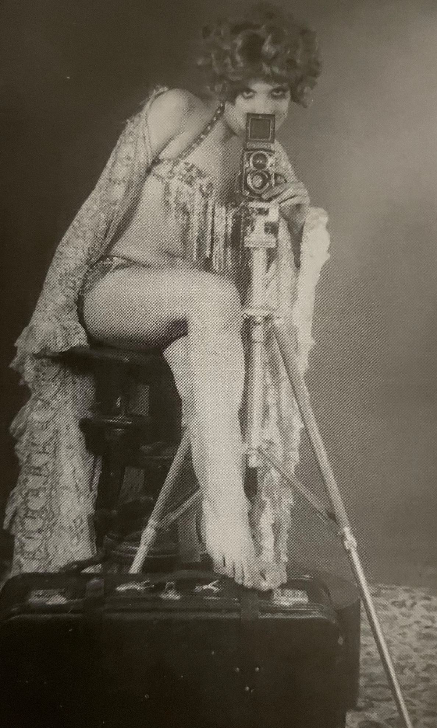
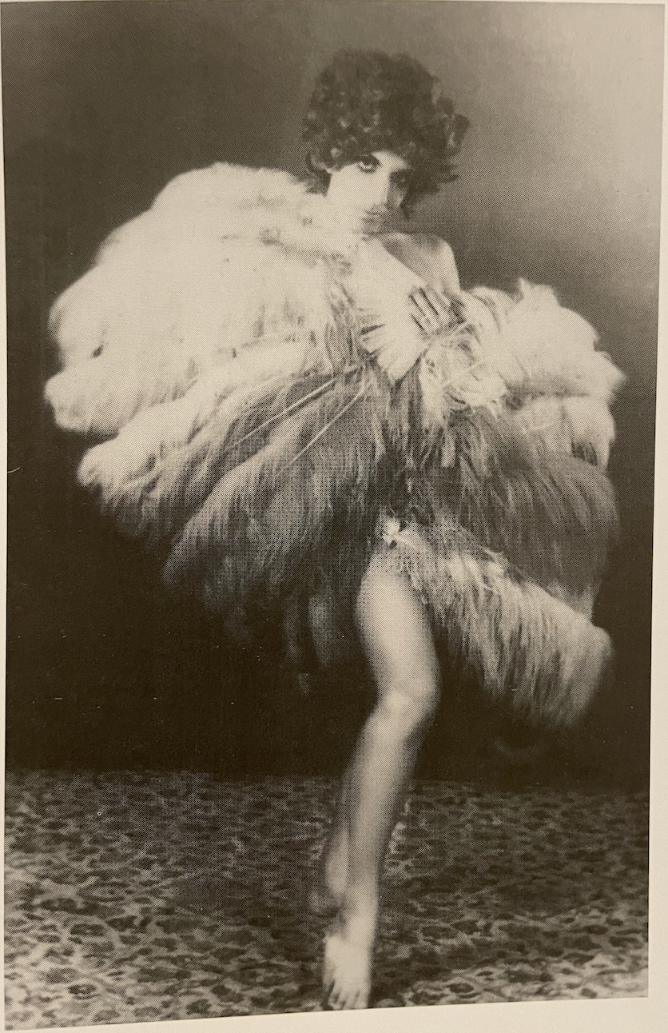
Notes:
Marzi Kanga and Saqib Malik, “The Princess and the Showgirl—In Conversation with Marzi.” Other. Pakistan's Radioactive Decade: An Informal Cultural History of the 1970s, eds John McCarry, Niilofur Farrukh, and Amin Gulgee (Karachi: Oxford University Press, 2019), 159.

Slide 6
Thank you!

Slide 7
References
Anwar, Khawaja Khursheed, dir. Chingari. Karachi: K.Z. Productions, 1964. https://www.youtube.com/watch?v=dHWZwBJmfJY.
Kanga, Marzi and Saqib Malik. “The Princess and the Showgirl—In Conversation with Marzi.” Other. Pakistan's Radioactive Decade: An Informal Cultural History of the 1970s, edited by John McCarry, Niilofur Farrukh, and Amin Gulgee, 157-162. Karachi: Oxford University Press, 2019.
Lido. “GRAND GALA OPENING TONIGHT: AMAL Belly Dance from Lebanon At your Favourite Night Club.” Advertisement. Dawn, March 2, 1968.
Mahmood, Arif, photographer. Marzi Kanga portrait. Photograph. In Tapu Javeri, Arif Mahmood, and Aesha Arif. Dou Rukh. Karachi: Markings, 2011.
Penthouse Nightclub. “YOU HAVE NEVER SEEN ANY THING LIKE THIS FOR A LONG TIME.” Advertisement. Dawn, November 17, 1973.
Section of a page. Dawn, December 24, 1973.
007. “007 Proudly presents.” Advertisement. Dawn, March 9, 1968.

