Slide 1
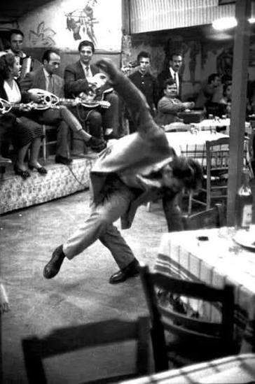
ZEIBEKIKO: YESTERDAY – TODAY – TOMORROW
Panagiotis Katsikis
CID Conference
Athens, Greece

Slide 2
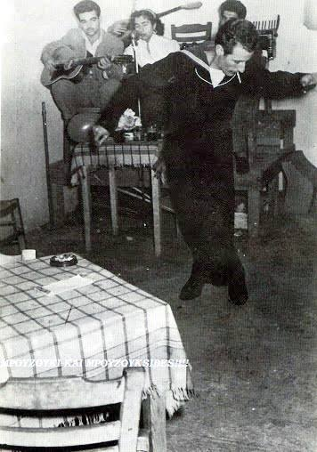
What is Zeibekiko?
• Greek urban folk dance
• Connection with Rebetiko music
• Personal expression
• Improvisational character

Slide 3
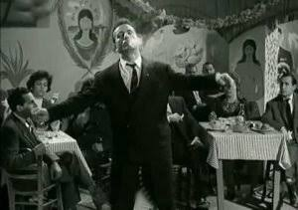
Historical Background
• Asia Minor roots
• Refugee movement after 1922
• Development in Greece
• Urban folk culture

Slide 4
Musical Characteristics
• 9/8 rhythm
• Rebetiko tradition
• Popular Greek music
• Improvisation

Slide 5
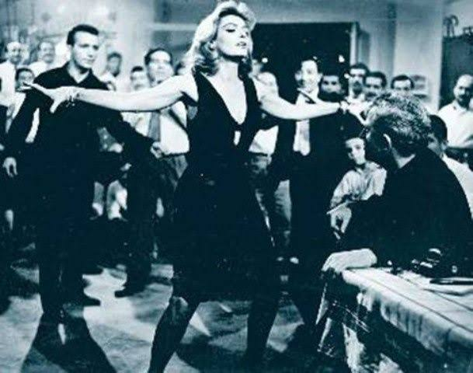
Social Role
• Refugee communities
• Working-class culture
• Identity and dignity
• Personal expression

Slide 6
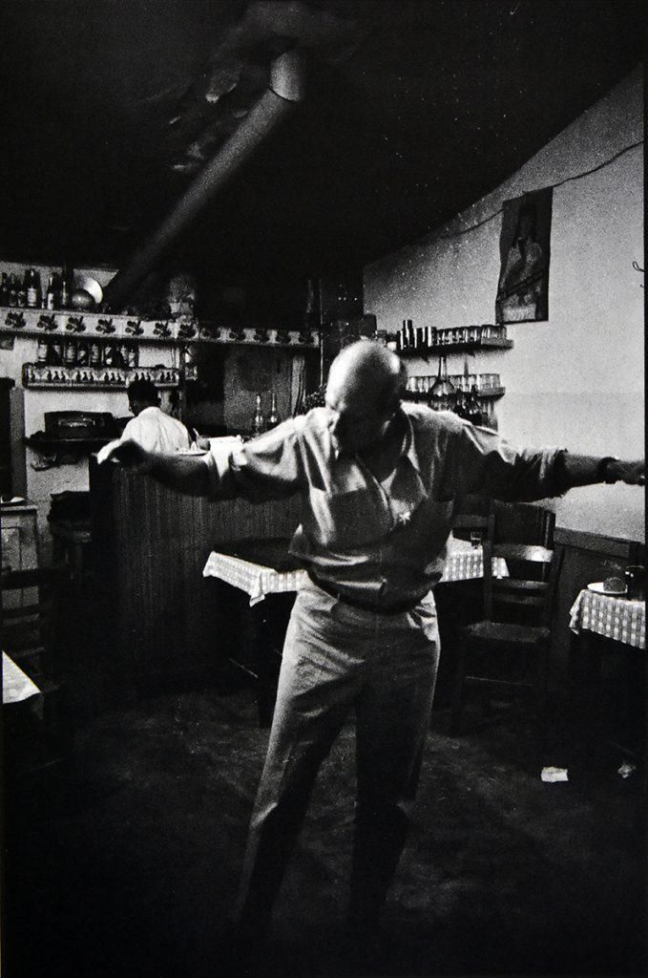
Zeibekiko Yesterday
• Pain
• Migration
• Survival
• Human experience

Slide 7
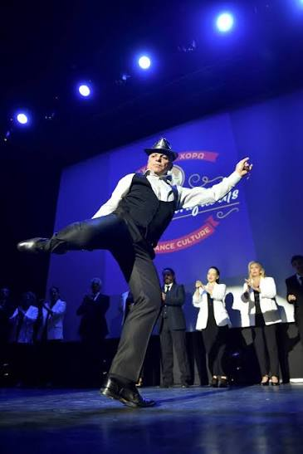
Zeibekiko Today
• Dance schools
• Cultural associations
• New generations
• Educational role

Slide 8
Modernization and Challenges
• Evolution
• Innovation
• Authenticity
• Cultural responsibility

Slide 9
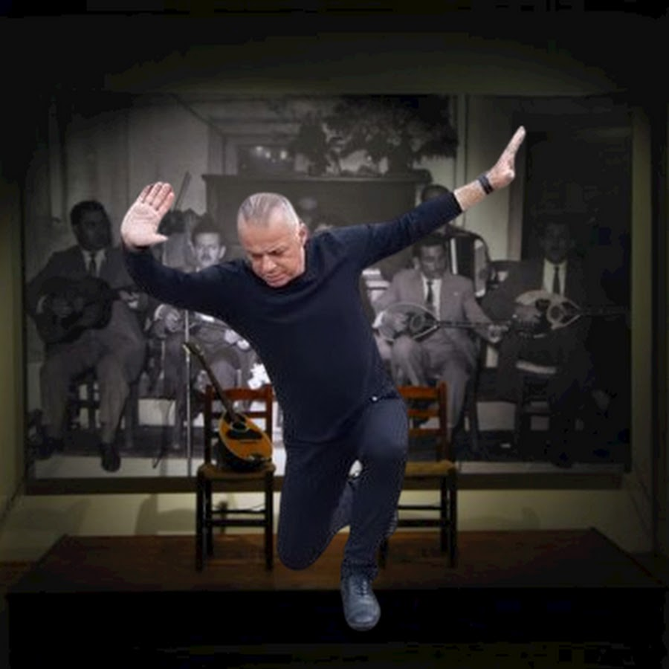
The Role of the Teacher
• Knowledge
• Responsibility
• Cultural transmission
• Human-centered teaching

Slide 10
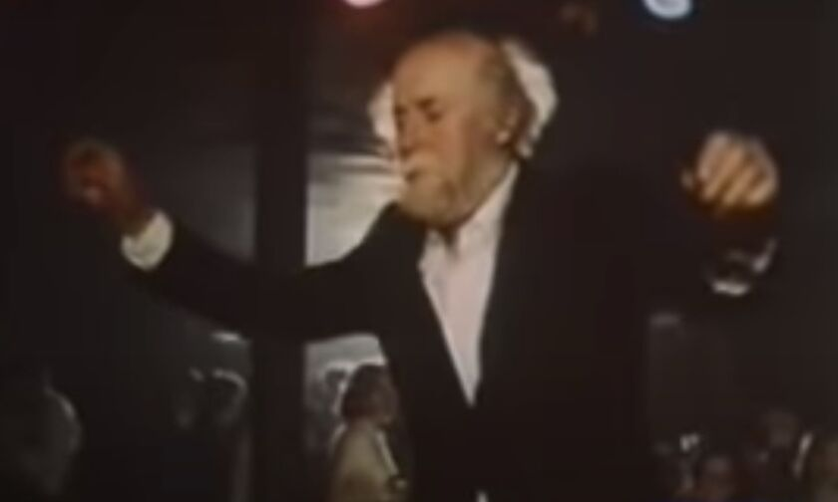
Age and Truth in Dance
• Life experience
• Emotional depth
• Authentic expression

Slide 11
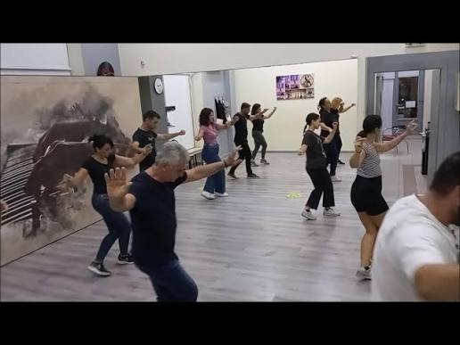
Zeibekiko Tomorrow
• Knowledge
• Respect
• Understanding
• Cultural continuity

Slide 12
Conclusion
Yesterday it was necessity.
Today it is a search.
Tomorrow it is a responsibility.
Zeibekiko does not ask for steps.
It asks for truth.

